Slide 1

Smart Cup Plate
Team 3

Slide 2
INDEX
01.
Introduction
- Introduce project personnel and topics
02.
Project Overview
- The purpose and necessity of the project
03.
Project scope
- Scope of project development
04.
Step-by-step project plans
and progress
- Step-by-step

Slide 3
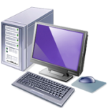




Team 3
Organization and Role
Team name
Team 3
Project
Leader
Choi Gitae
HW Part
Lee Daehee
SW Part
Park Hyunwook
Design
Park Jinug

Slide 4
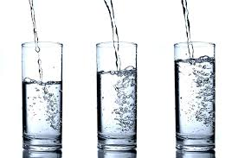
Project Introduction
Smart Cup Plate
How much water
do you Drink in daily?

Slide 5


Project overview
Purpose and necessity
Our body is made up with 70% of water
Severe thirst when 1 to 2% of water is insufficient
Young children is made up with 90% of water
3% deficient pulse, respiratory increase
If 12% is lost, the crisis of life

Slide 6

Project overview
Suggested daily water
About 2L of water = 8 to 10 glasses of water
The recommended daily water is 2 liters.
Depending on the water cup, about 8 to 10 cups of water are appropriate.

Slide 7
Project overview
Purpose and necessity
Insufficient water intake
However, Modern peoples drink very few amount of
water compare with the increase intake of sodium.
Project for modern people's to drinking water
To improve this, We came up with a idea developing
a Smart Cup Plate system. Using a conventional cup plate
intended to promote water intake of modern people.
We will add some helpful functions related in drinking water.

Slide 8
Project overview
Project highlight
H/W
Weight Sensor
Buzzer
S/W
Measure
(Amount, Weight)
Push Alarm
Statistics
LED
Bluetooth
S/W
H/W
Design
Smart Cup Plate
Goal : Successful finish of the project

Slide 9




Project scope
Project highlight
[Service purposes] Health Promotion Through drinking water
Diet
Services
Health improvment services
[Program Features] Distribution H/W, S/W
Moblie Function
HW Function
Measurement of amount
Measurement of weight
Print of Intake information
Alarm
Weight sensors
Buzzer
LED
Bluetooth

Slide 10
Project scope
Detail of project scope
Part | Task Scope | Detail | Explanation
SW (Mobile) | Function of measuring | Informs the user of the recommended water intake | Through the App, you can check the amount of water you drink before and how much more you have to drink.
 | User Information function | User can fill out their information in the app. | The user can enter their information. If the information is filled, The App will calculate the recommended water intake for each user's weight.
HW (Device) | Buzzer function | It tells the time when you have to drink. | The Smart cup plate has a buzzer that will tell you to drink water in a specified time.
 | LED function | Additional notifications using LED | LED will show you the current process. If you don’t drink enough water the LED will change it’s color to red. (In normal it’s green)
 | Bluetooth function | Link the Smart cup plate and App wirelessly | By using Bluetooth, we don’t need any nasty wire in our development and it’s more comfortable to use it.

Slide 11
Project scope
Detail of project scope
Approximate Step-by-Step Perform Process
HW Analysis
HW Design
Technology
Trends Analysis
H/W Functional
Analysis
Defining the
scope of
Function
Detailed
definition of
devices
Started to
develop
Design drawing
Planning
Pre-search
Implementation
Select topics
Make-up
Team
Schedule
Define Roles
Perform plan
Feasibility
Check
Search about a
Similar case
IT Techs Status
Business Status
Final Test
Documents
for the final
result
Maintenance
SW Analysis
SW Design
Check the
Available
technology
H/W Functional
Analysis
Deriving the
Implementing
functions
Development of
Functions
Process Design
Interface Design
Debugging

Slide 12
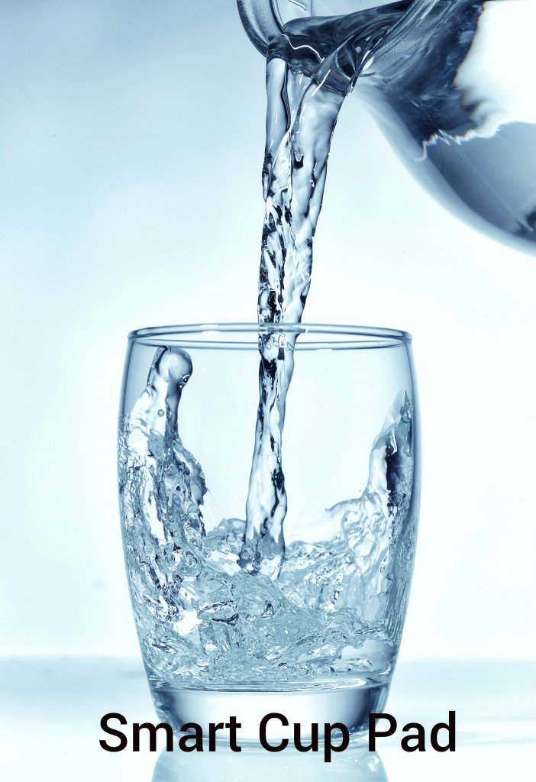
SW development
Proto-type development
Notes:
최초 스플래시 아트 버튼을 누르면 업데이트 했다는 내용이 들어가야겠지?

Slide 13
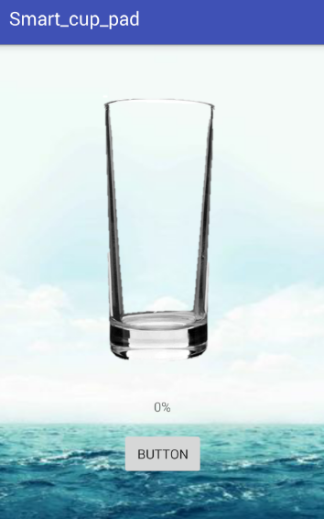
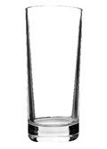
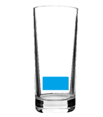
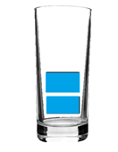
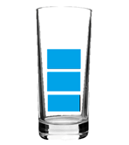
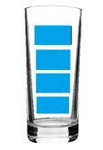
SW development
Proto-type development
Notes:
최초 스플래시 아트 버튼을 누르면 업데이트 했다는 내용이 들어가야겠지?

Slide 14
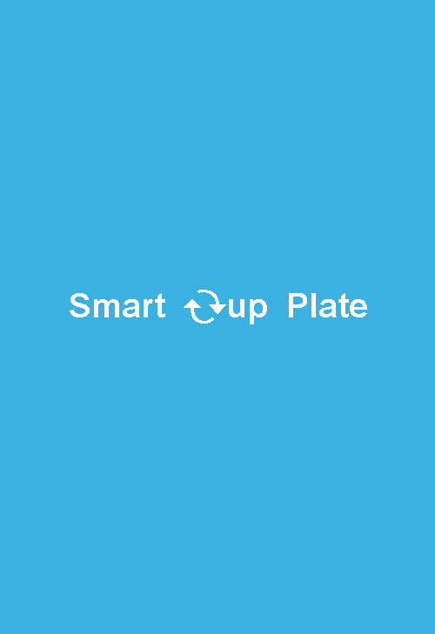
SW development
Proto-type development2
Notes:
변화된 스플래시아트

Slide 15
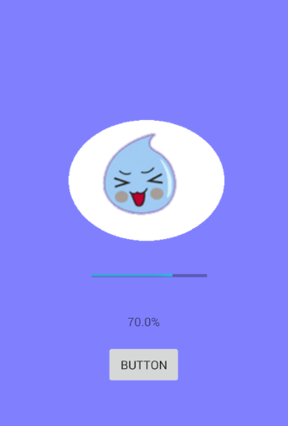
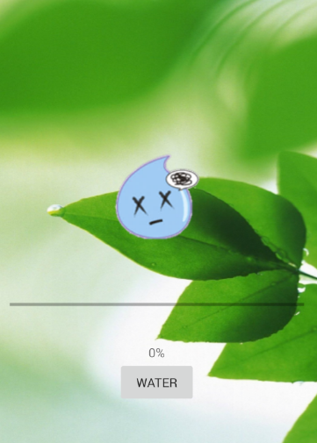
SW development
Proto-type development
2nd
3rd

Slide 16
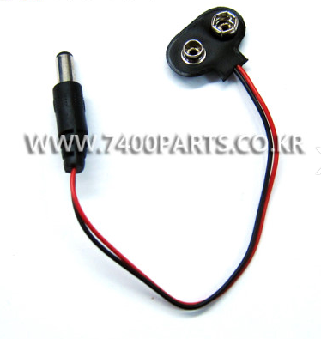
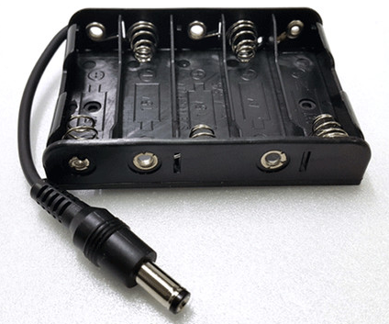
HW development
Hardware issue
Notes:
무엇을 사용할 것인가.

Slide 17
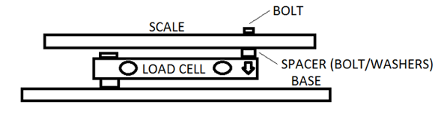
HW development
Hardware issue

Slide 18
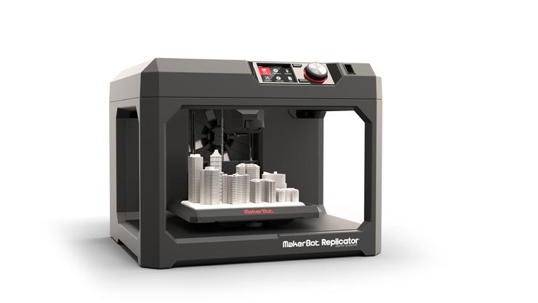
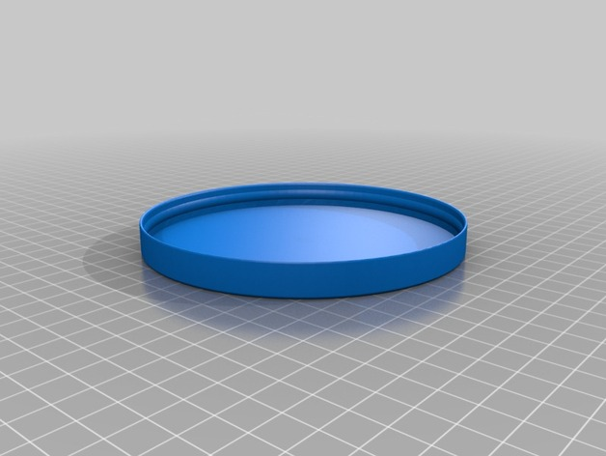
HW development
design issue
Making plate with 3D print

Slide 19
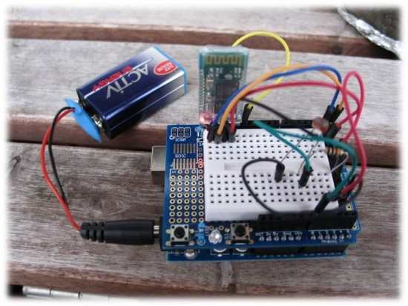
HW development
Ideal
Notes:
이런 식으로 하고자함.

Slide 20
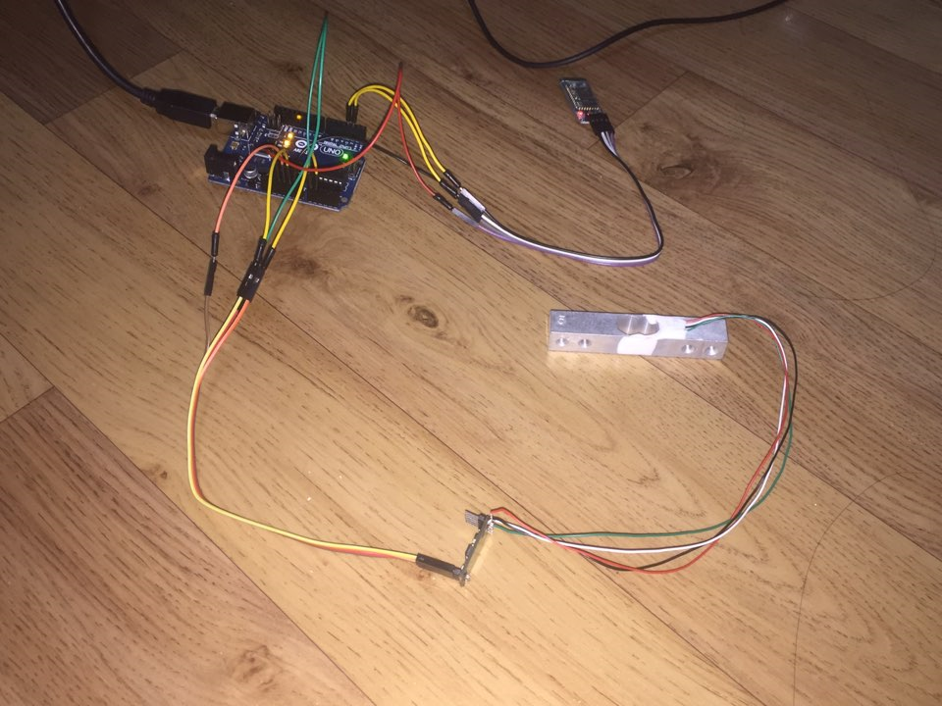
HW development
present

Slide 21
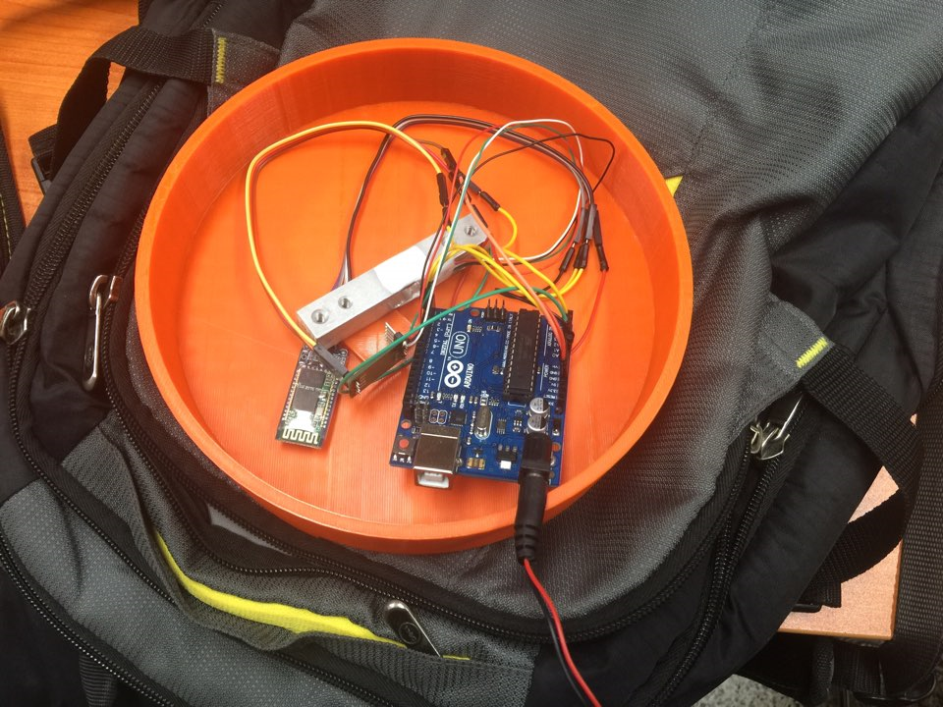
HW development
present

Slide 22


QNA
Thank you
Notes:
땅크 유

